Slide 1
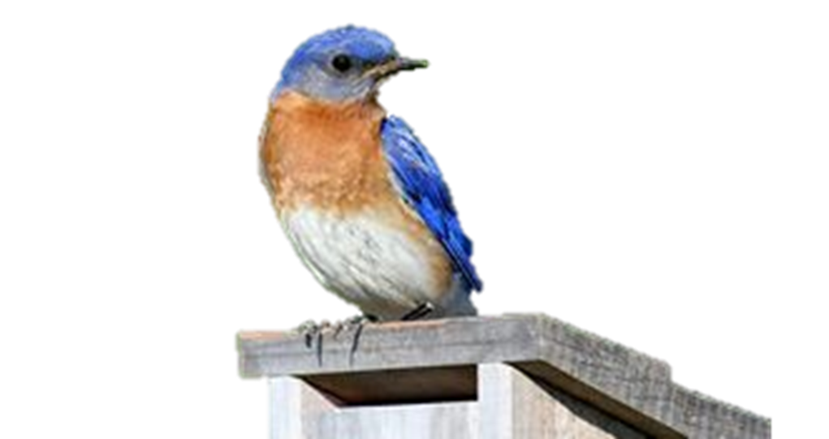
VAST Challenge 2018
Mini Challenge 3
By: Akshat Baranwal

Slide 2
VAST Challenge Background
The Visual Analytics Science and Technology (VAST) Challenge is a yearly competition that is designed to advance visual analytics research through synthetic, but realistic data sets and analytical tasks.

Slide 3

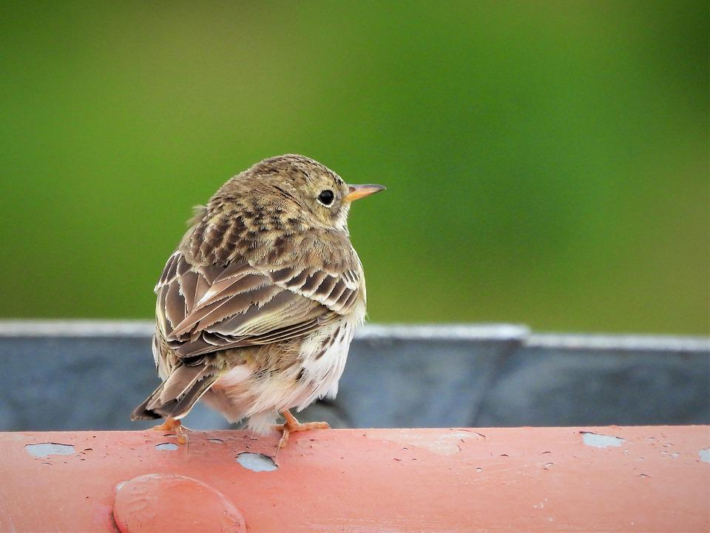

The Problem
Company :
Kaisos International is a huge multinational conglomerate with factories around the world.
Context :
Suspicious chemical contaminating endangered birds like Rose-Crested Blue Pipit and the Greater Eurasian Red-Throated Pipit.
Problem Statement :
Need to find out who is affecting and contributing to the endangerment in Misford, as well as who is making the suspicious purchases and having secret meetings.

Slide 4
Mini Challenge 3 Background
Leader of Kassios has been developing AGOC-3A, a safer chemical.
Customers are angry that AGOC-3A is not as effective as Methylosmoline.
Leader calls a meeting and asks group to secretly buy Methylosmoline. They communicate, meet and ultimately purchase some Methyl precursors
We were sent company purchase data and communications data to deduce who are the guilty members of the company.

Slide 5
Who is making suspicious purchases or having secret meetings?
4 Data Sets
Calls - 534,000 nodes and 10.6 million edges
Emails - 526,000 nodes and 14.6 million edges
Purchases - 227, 000 nodes and 762,000 edges
Meeting - 101,000 nodes and 127,000 edges

Slide 6
How the Data is Connected
Destination
0 - Calls
ETypes:
0, 1, 2, 3
Time Stamp
Destination
Initiator/Source (Employee ID)
Transaction Type
1 - Emails
Time Stamp
2 - Purchases
Destination
Employee Name (First & Last)
Time Stamp
3 - Meetings
Destination
Time Stamp

Slide 7
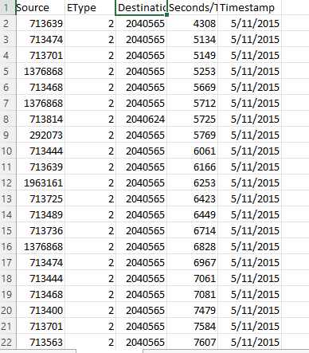
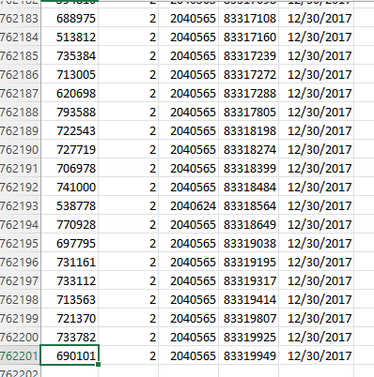
Purchases Data

Slide 8
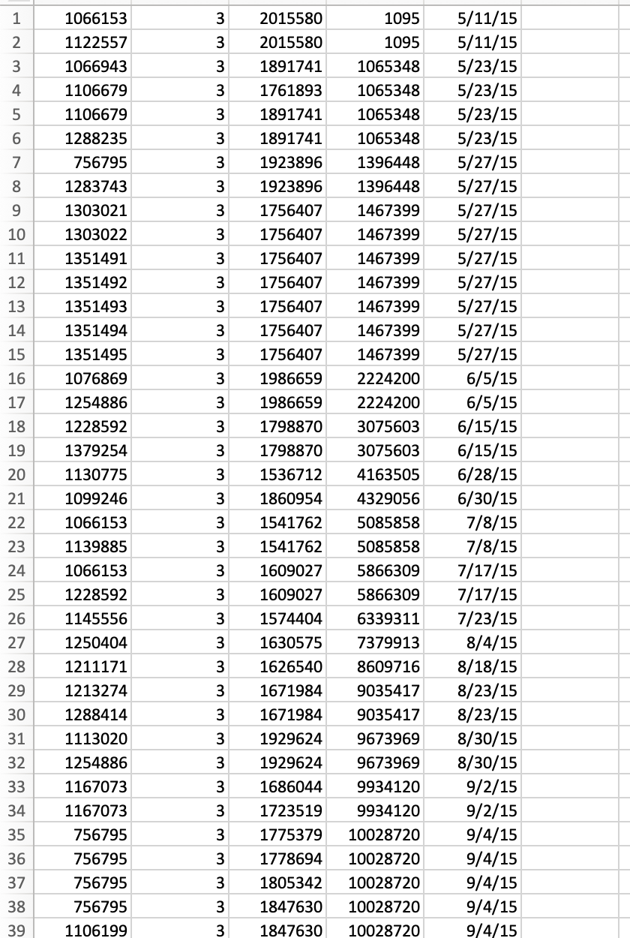
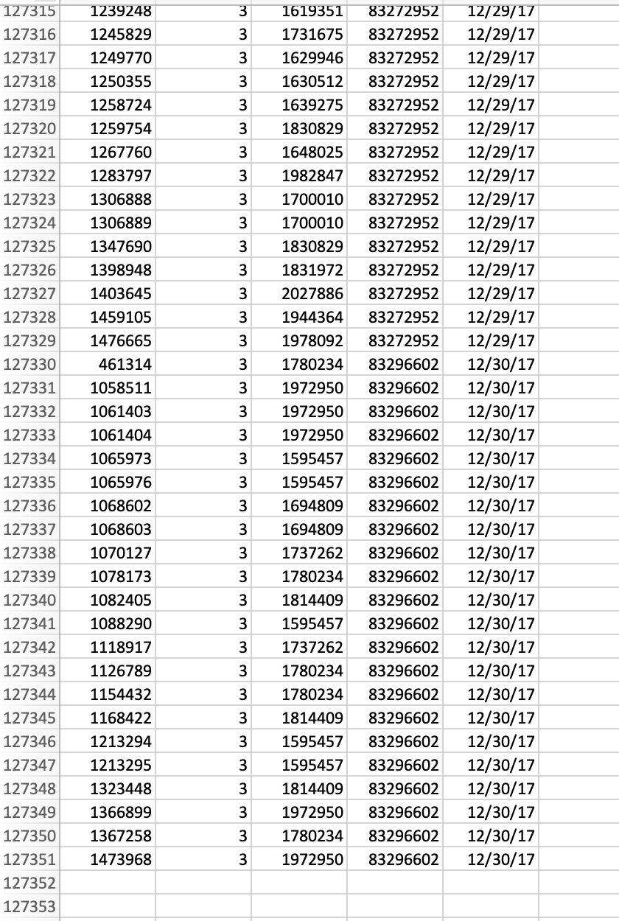
Meetings Data

Slide 9
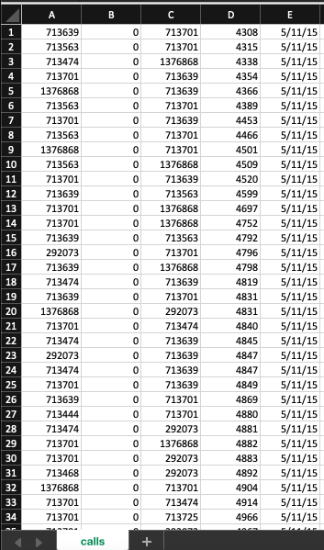
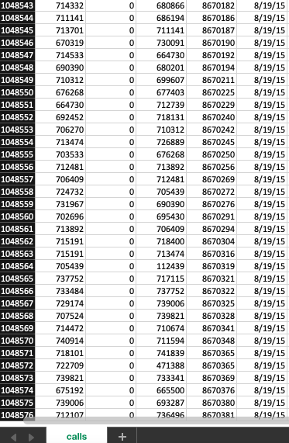
Calls Data

Slide 10
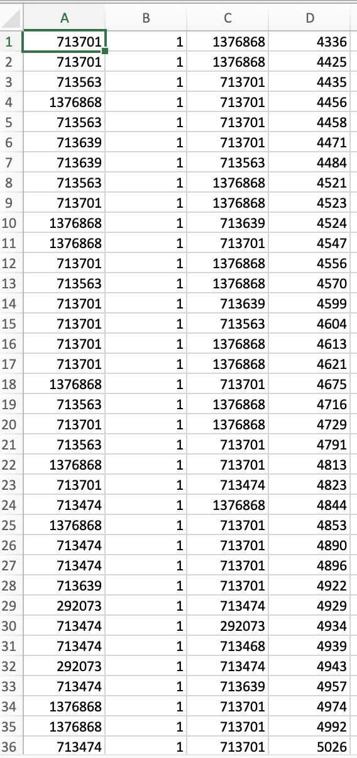
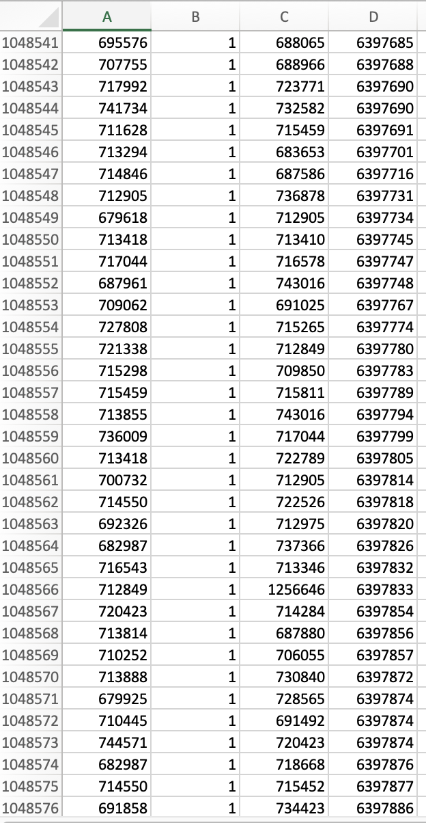
Emails Data

Slide 11
Question 1
Using the four large Kasios International data sets, use the different sources to create a picture of the company. Characterize changes in the company over time.
According to the company’s communications and purchase habits, is the company growing?

Slide 12
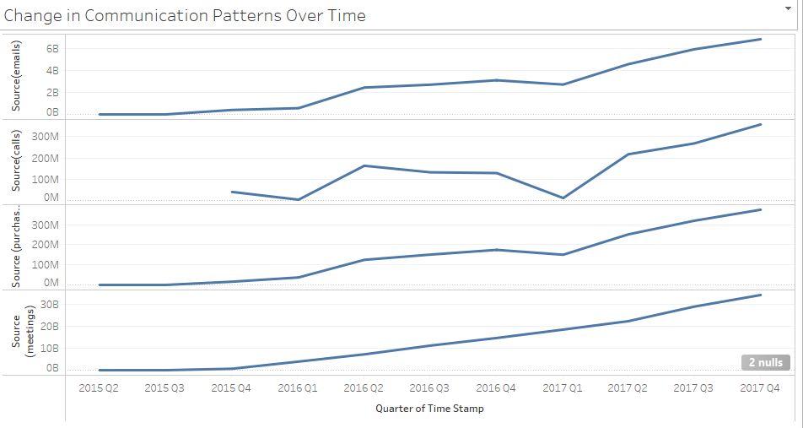
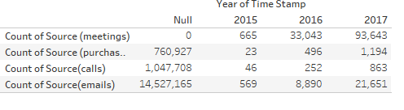
Is the Company Growing?
Yes, the company is growing. All datasets are increasing overtime.

Slide 13
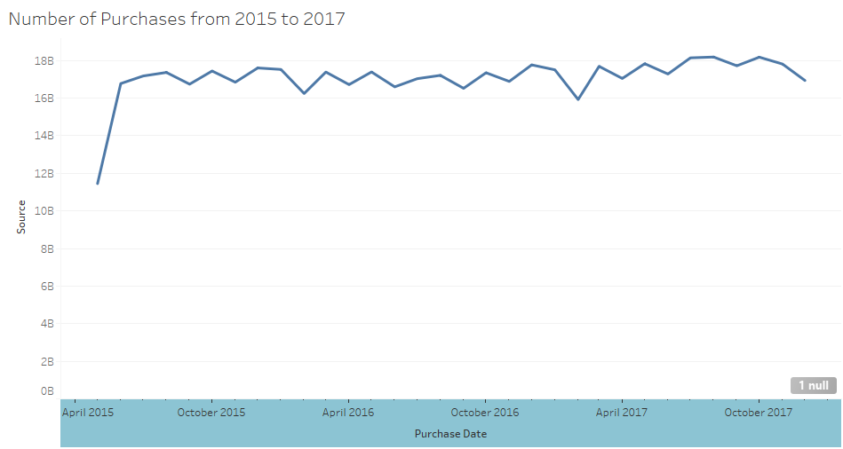
Purchase Growth from 2015 to 2017

Slide 14
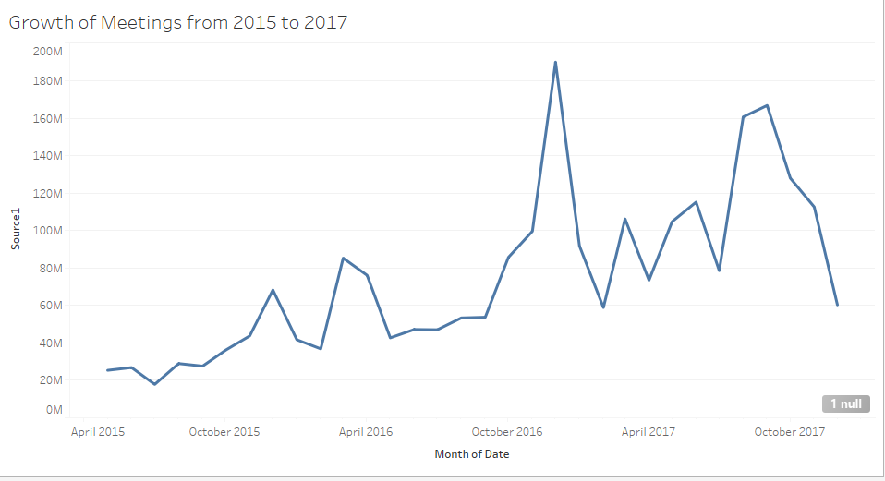
Meetings Growth from 2015 to 2017

Slide 15
Question 2
Combine the four data sources for group that the insider has identified as being suspicious and locate the group in the larger dataset.
Determine if anyone else appears to be closely associated with this group. Highlight which employees are making suspicious purchases, according to the insider’s data.

Slide 16
Suspicious Employees
Alex Hall, Lizbeth Jindra, Patrick Lane, Richard Fox, Sara Ballard, May Burton, Glen Grant, Dylan Ballard, Meryl Pastuch, Melita Scarpaci, Augusta Sharp, Kerstin Belveal, Rosalia Larroque, Lindsy Henion, Julie Tierno, Jose Ringwald, Ramiro Gault, Tobi Gatlin, Refugio Orrantia, and Jenice Savaria.

Slide 17
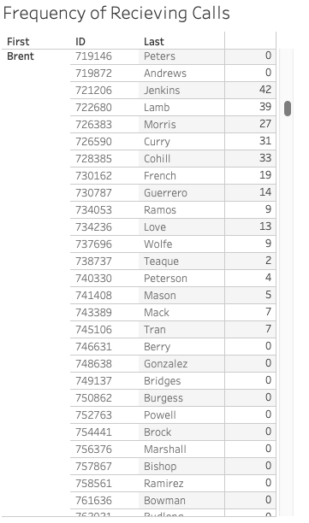
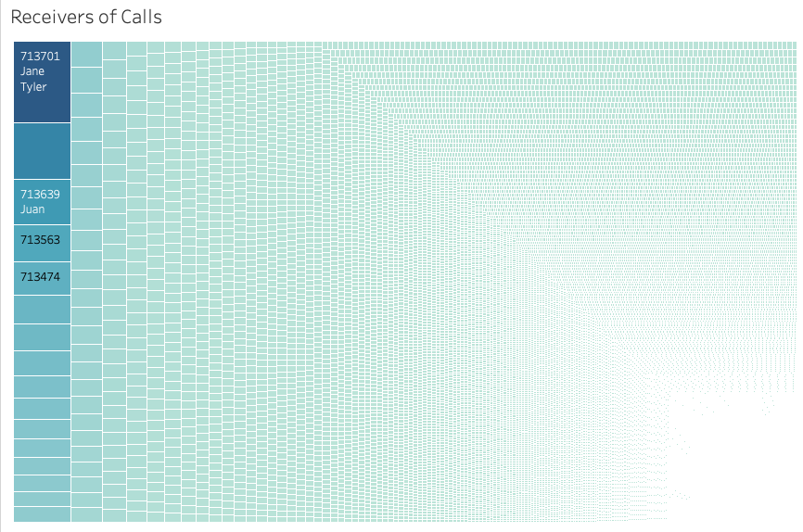
Calls

Slide 18
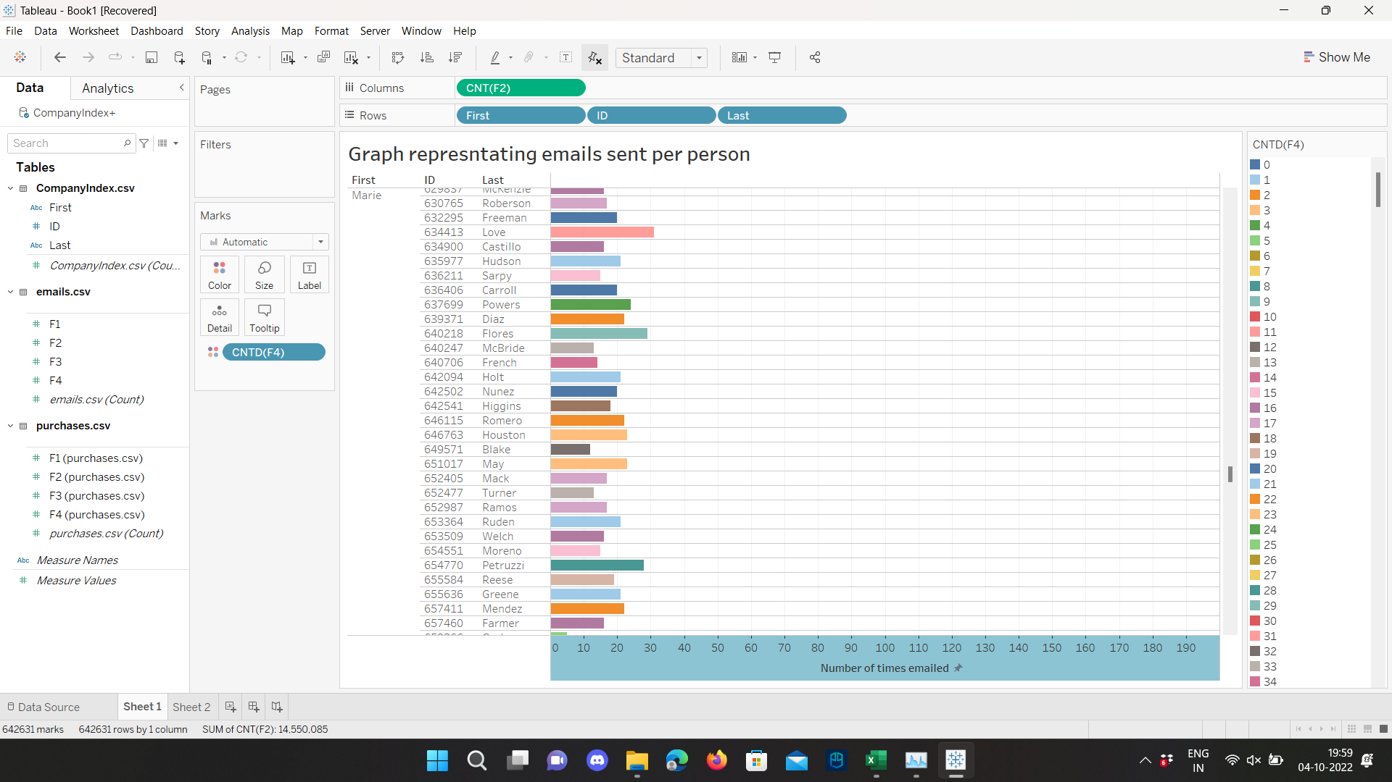
Emails

Slide 19
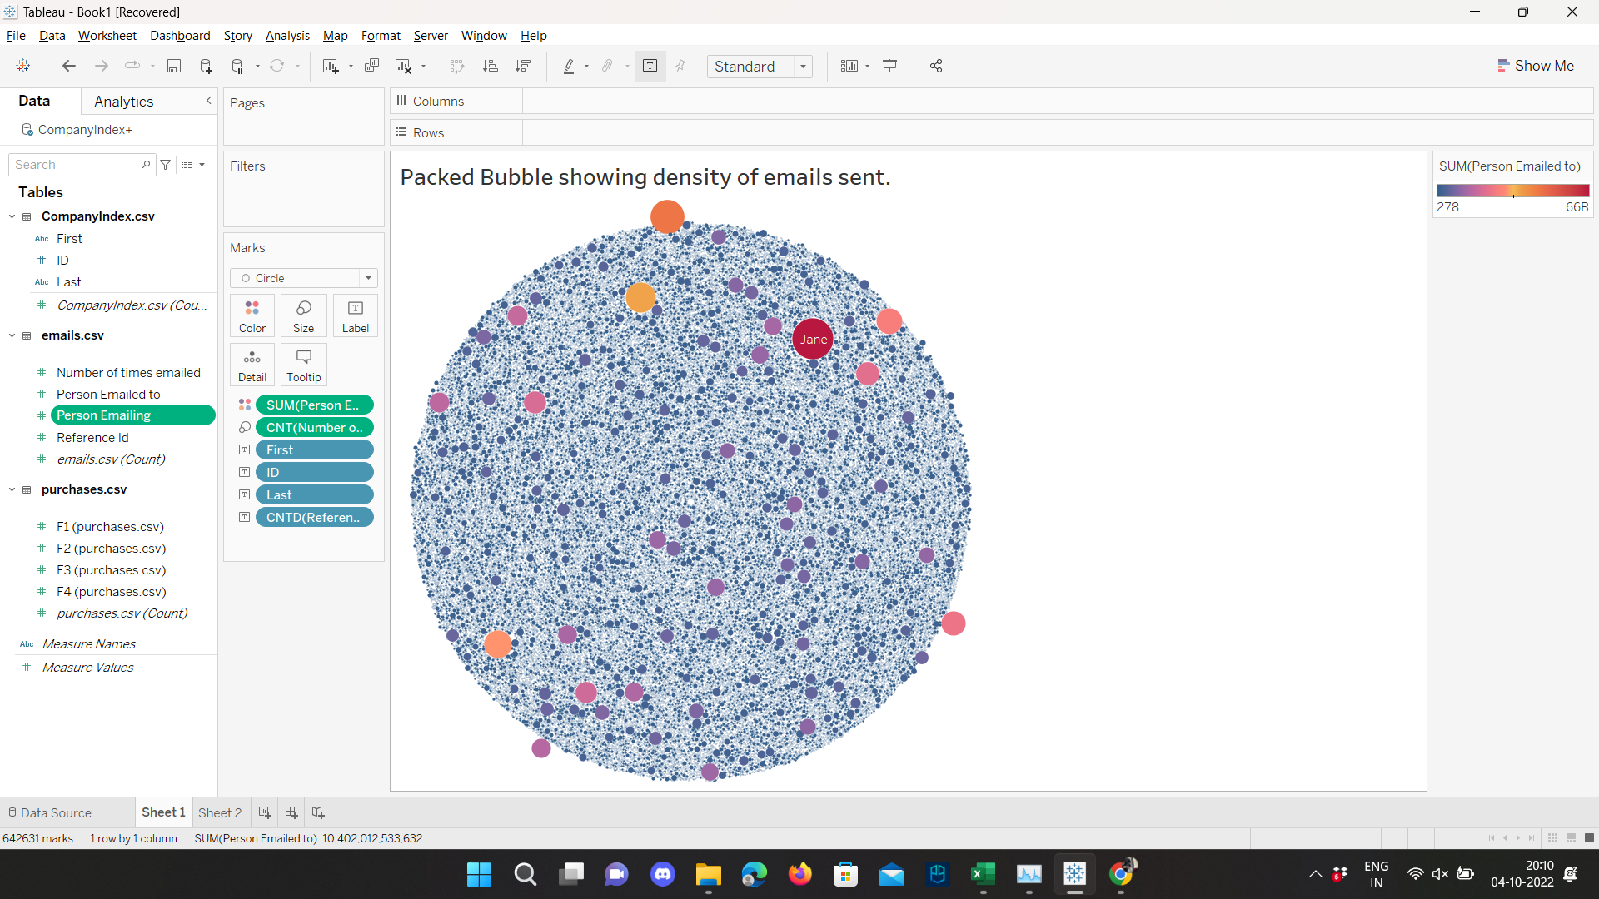

Slide 20
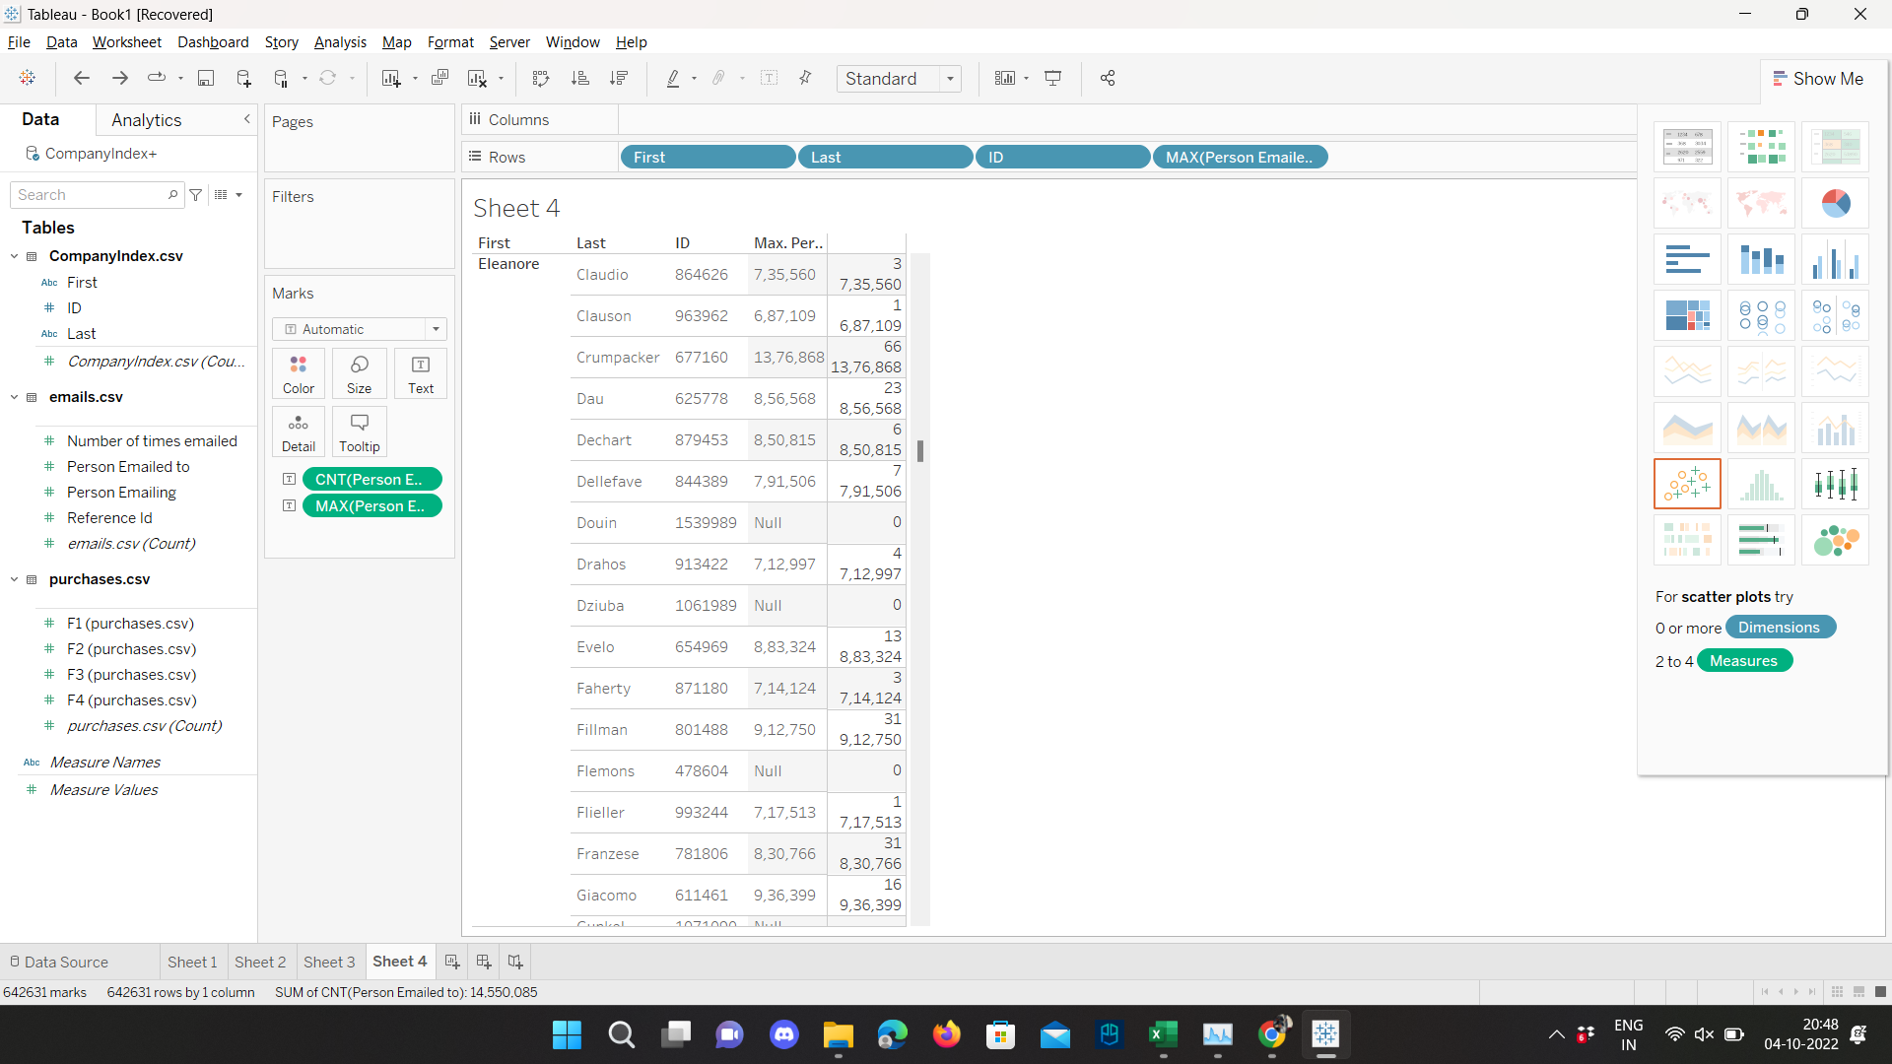
Data sorted in a way showing who emailed who and how many times:

Slide 21
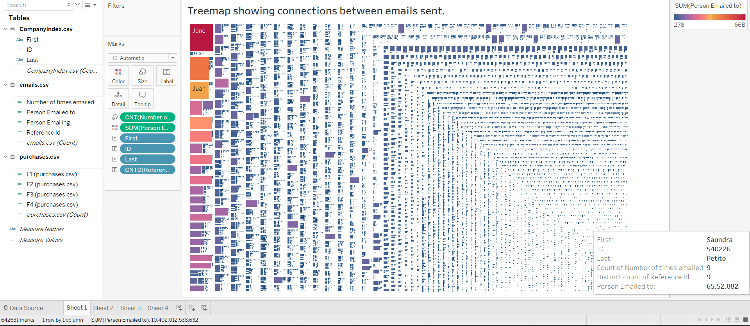
Treemap:

Slide 22
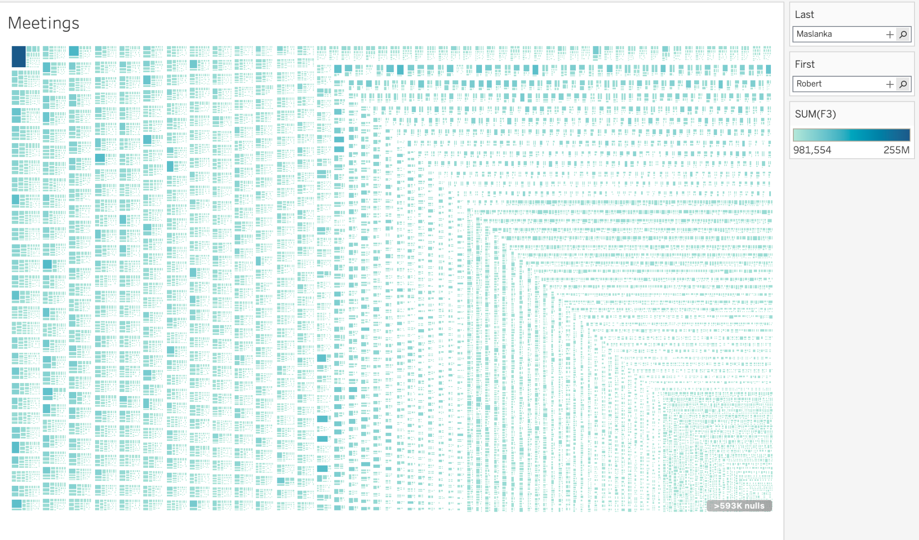
Tree Map Meetings
Notes:
Jennifer Curreri

Slide 23
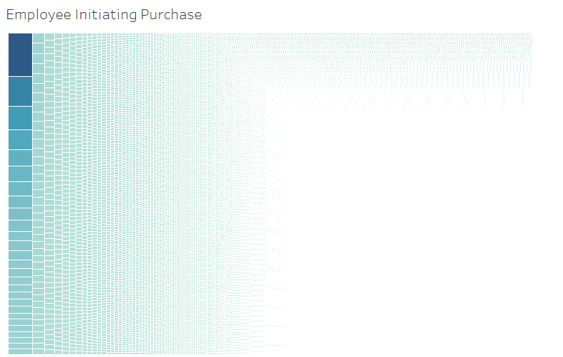
Purchases Tree Map

Slide 24
Challenge Question 3
Using the combined group of suspected bad actors you created in question 2, show the interactions within the group over time.

Slide 25
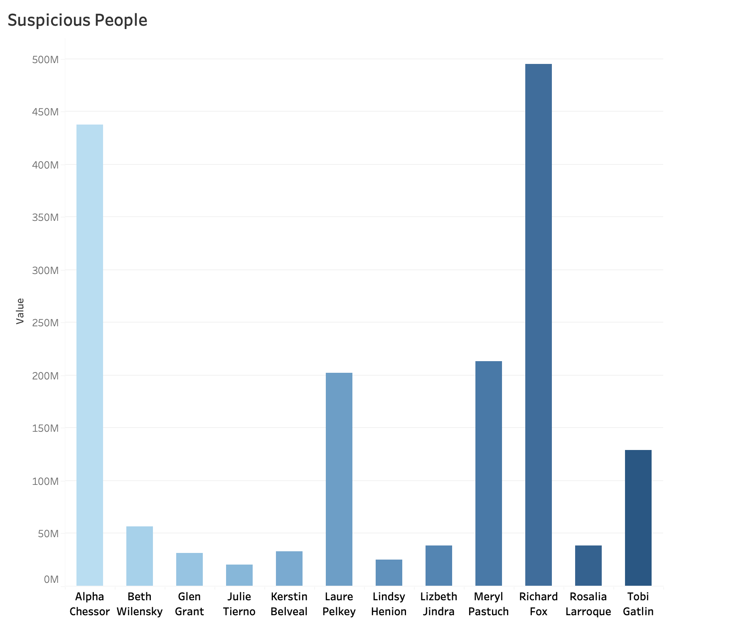
Employee who Initiated Communication
Suspicious people:
Julie Tierno, Kerstin Belveal, Beth Wilensky, Glen Grant, Lindsy Henion, Lizbeth Jindra, Rosalia Larroque, Tobi Gatlin, Alpha Chessor, Laure Pelkey, Meryl Pastuch, and Richard Fox

Slide 26
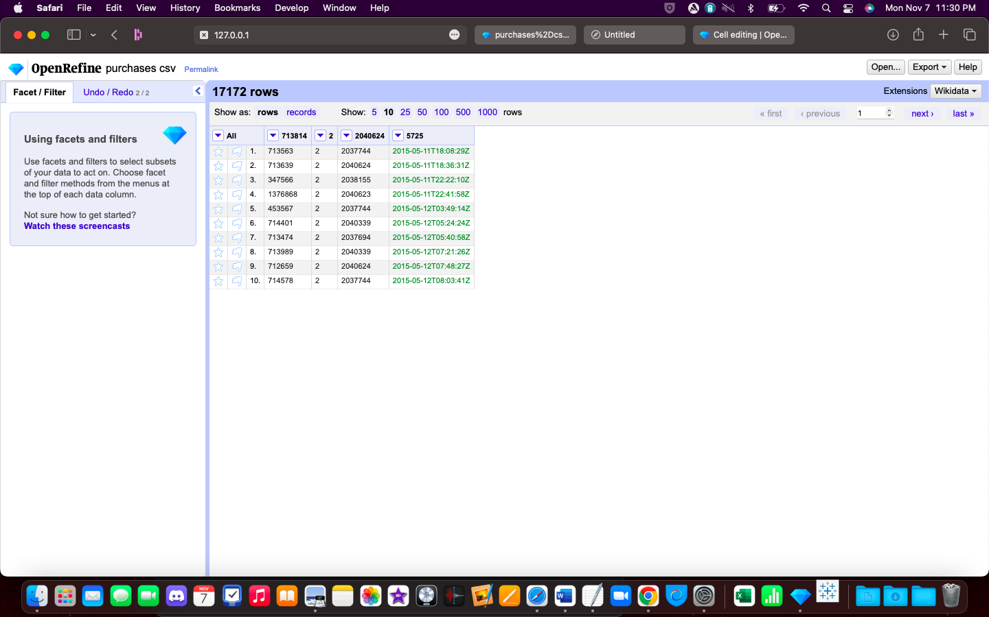
Taking them out left us with roughy 2 % of purchase data.
Notes:
17172/762,200 = roughly 2%

Slide 27
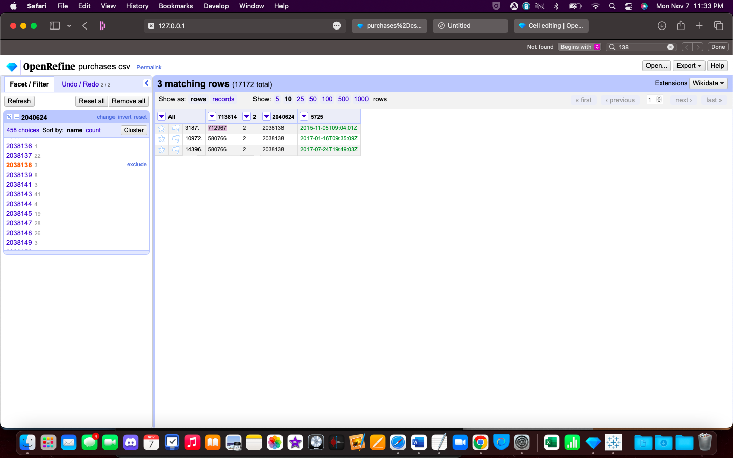
Sifting through this data by looking at other purchase by those from the suspicious list led us to 3 names.
Pearl Tran
Almeta Evancho
Jane Ramsey

Slide 28
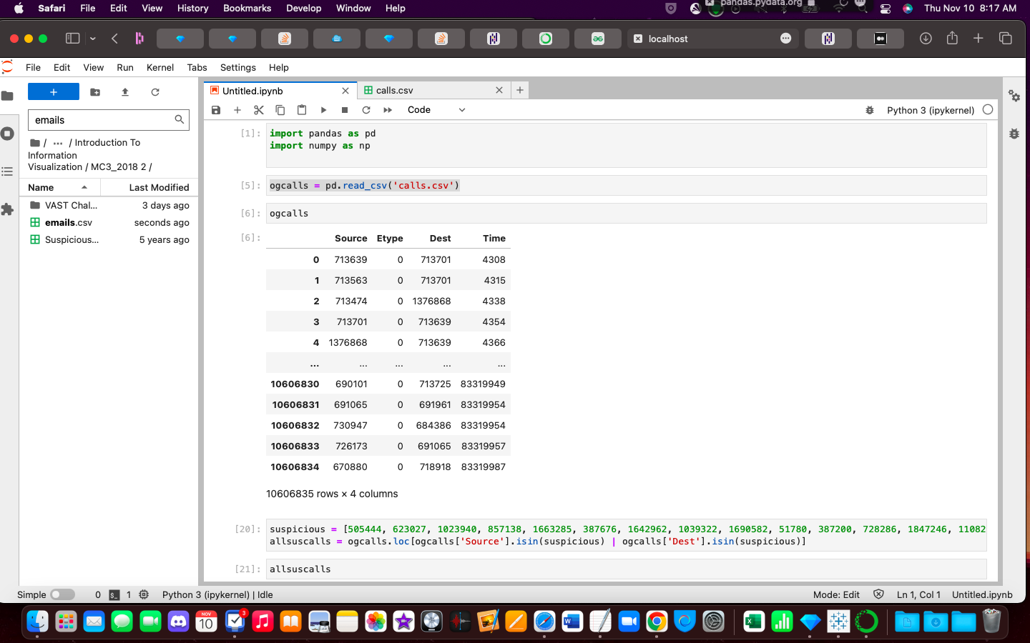

Slide 29
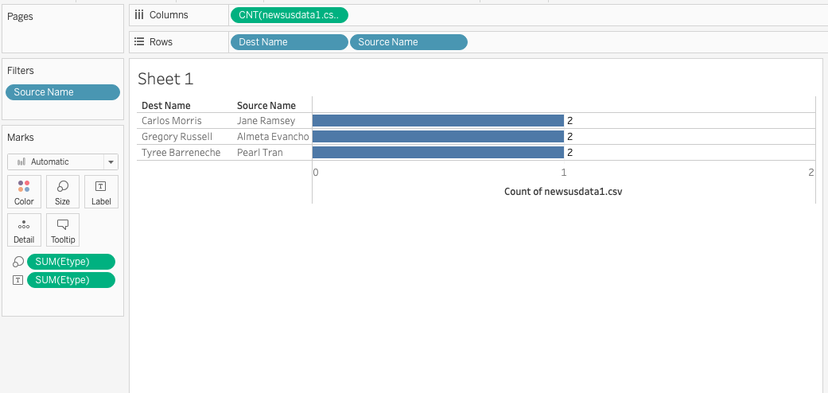
They each only had 1 purchase and no communications so it is unlikely they are suspicious.

Slide 30
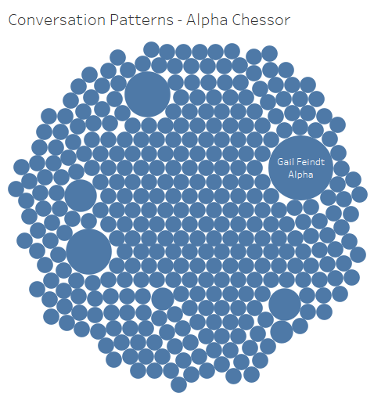
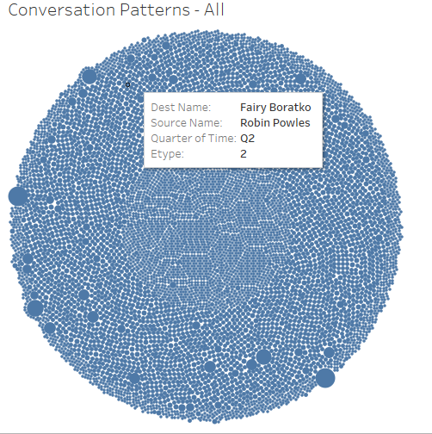
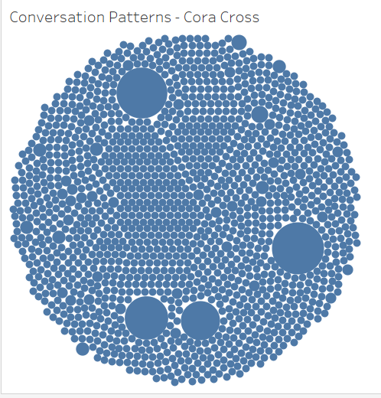

Slide 31
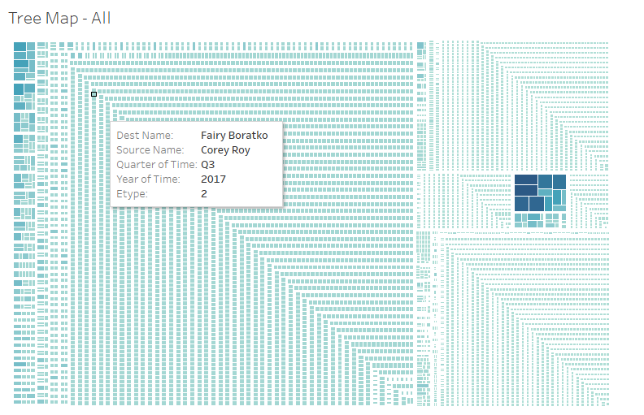
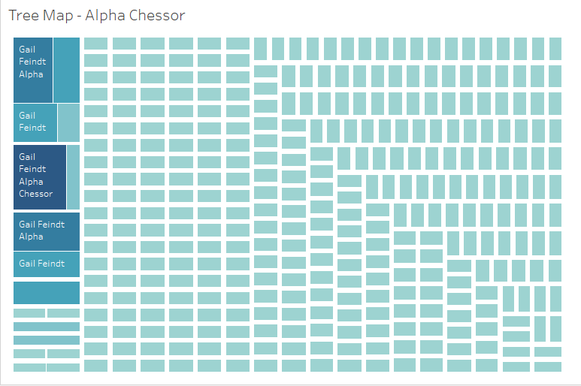
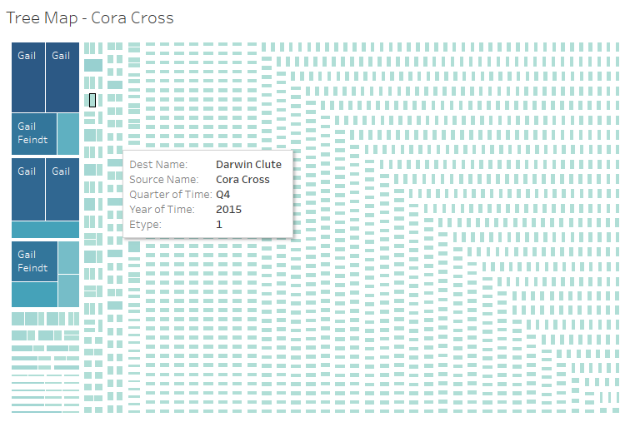

Slide 32
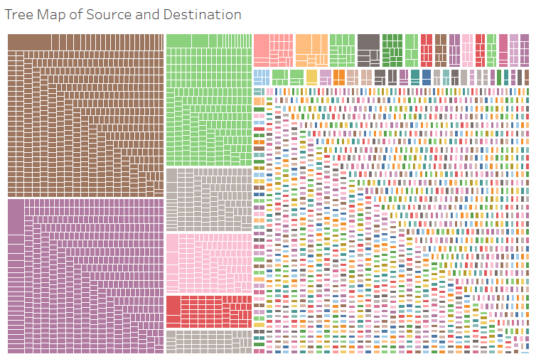
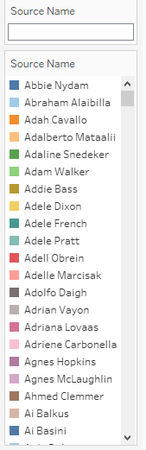

Slide 33


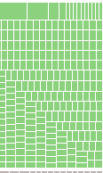
Source: Alpha Chessor
Source: Richard Fox
Source: Laure Pelkey

Slide 34
Challenge Question 4
The insider has provided a list of purchases that might indicate illicit activity elsewhere in the company. Using the structure the first group noted by the insider as a model can you find any other instances of suspicious activities in the company?
Are there other groups that have structure and activity similar to this one? Who are they?
Each of the suspicious purchases could be a starting point for your search. Provide examples of up to two other groups you find that appear suspicious and compare their structure with the structure of the first group. The structures should be presented as temporal not just structural (i.e., the sequence of events—A is followed by B one or two days later—will be important).

Slide 35
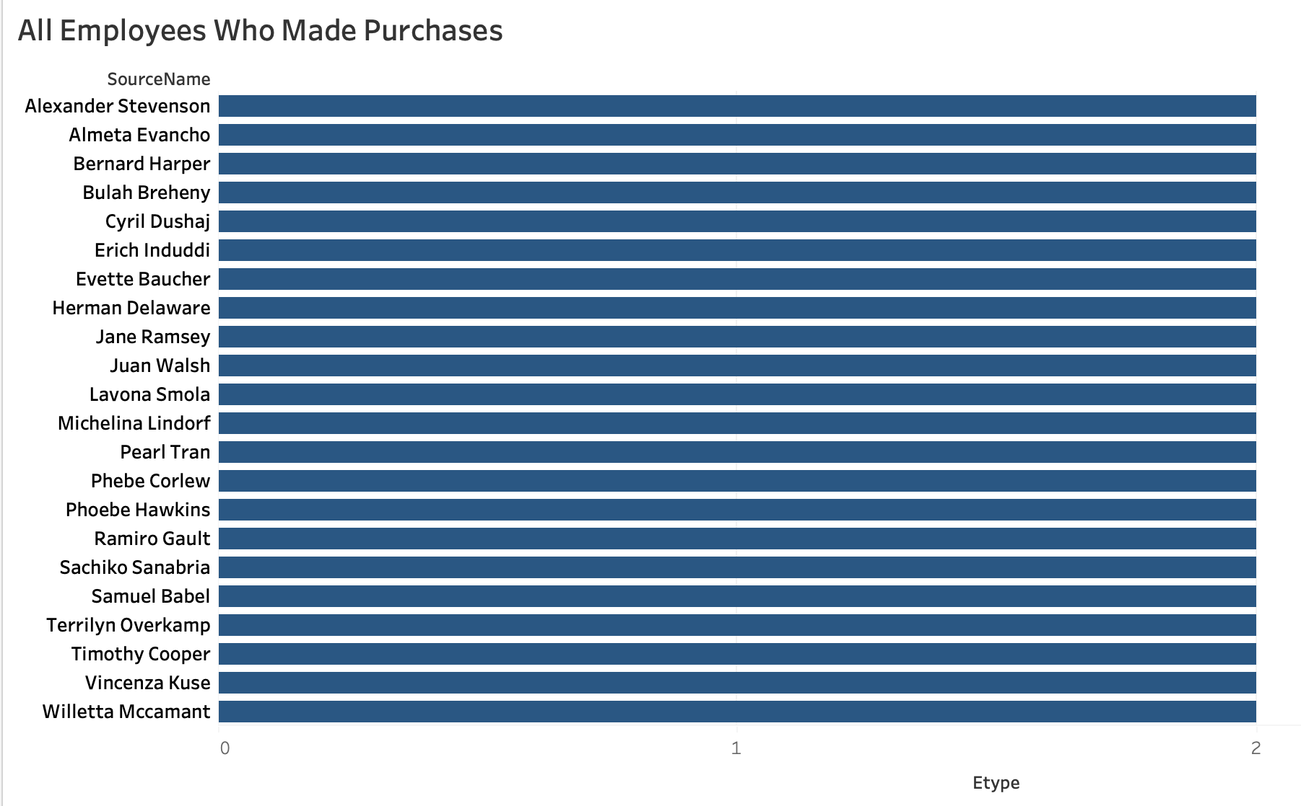

All Suspicious Employees who made Purchases
.
Kerstin Belveal

Slide 36
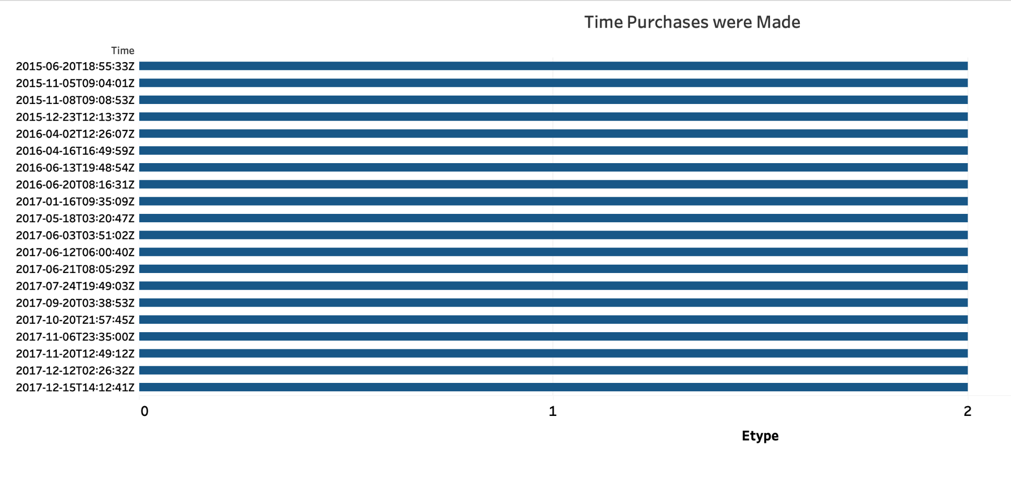
Time Purchases were made

Slide 37
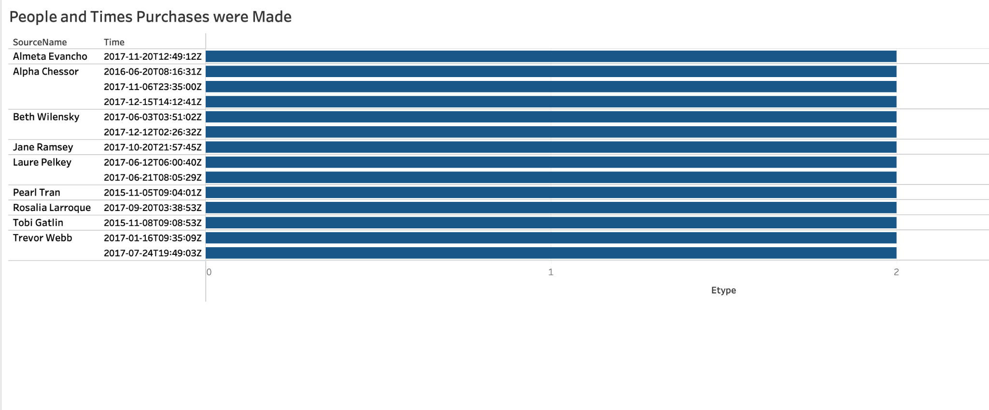
Employees and Times Purchases were Made
People who made multiple purchases:
Alpha Chessor, Beth Wilensky, Laure Pelkey, and Trevor Webb

Slide 38
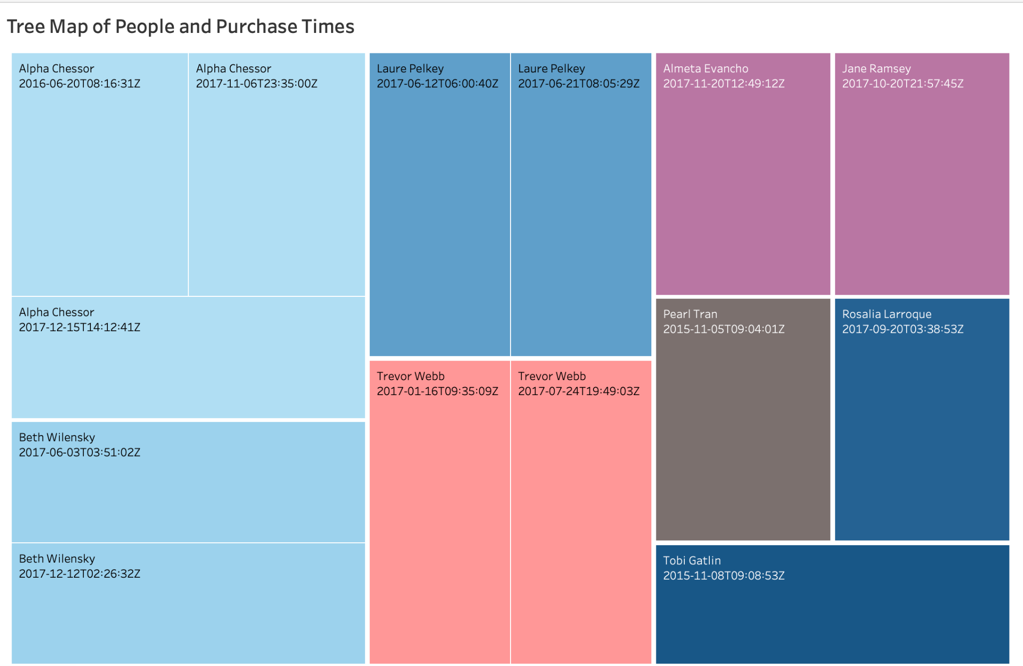
Tree Map of Employee and Purchase Times

Slide 39
Finding Suspicious people by other approach.
Apart from finding suspicious people through how my teammates tried to find it, I tried different approach by going through list of a file consisting of suspicious people contacting each other at different-different time. Out of how the results were, I went through the most number of conversations happened between suspicious people. Then later, in the list of suspicious purchases, I actually cross verified whether the purchase was made or not. The next following slides will explain everything about the process.

Slide 40
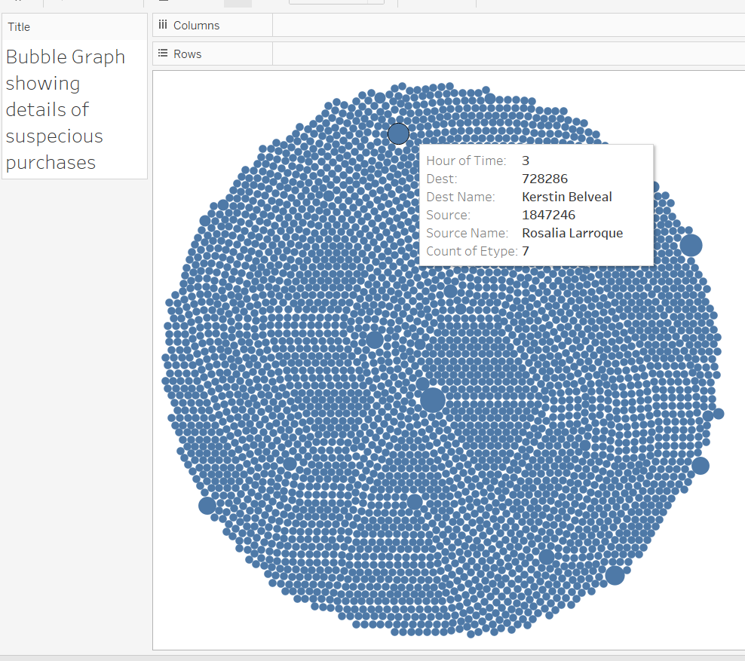
Using Tableau, got to know about suspicious people having conversation at different-different time.
From here I chose suspicious people having conversation most of the time (Bigger circle represents more number of conversations).
For e.g.
I took, Kerstin Belveal (728286) and Cora Cross (320914) in consideration.

Slide 41
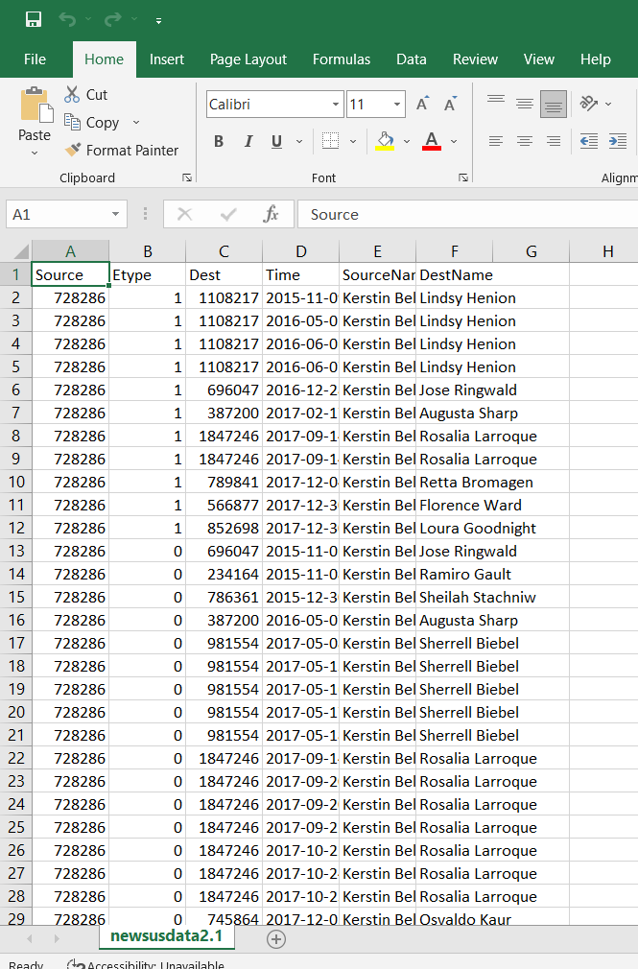
Then with the help of excel, I created a file with only one individual’s conversation as source and destination.
I used advance feature of in data menu of excel to find the individual’s name from the purchases happened.
From their record, I came to know that some of the people are having conversation late in the night and not just one time but so many times
In this, I took the name of the person not only as source but also as destination as I wanted to see if people conversate with them back.

Slide 42
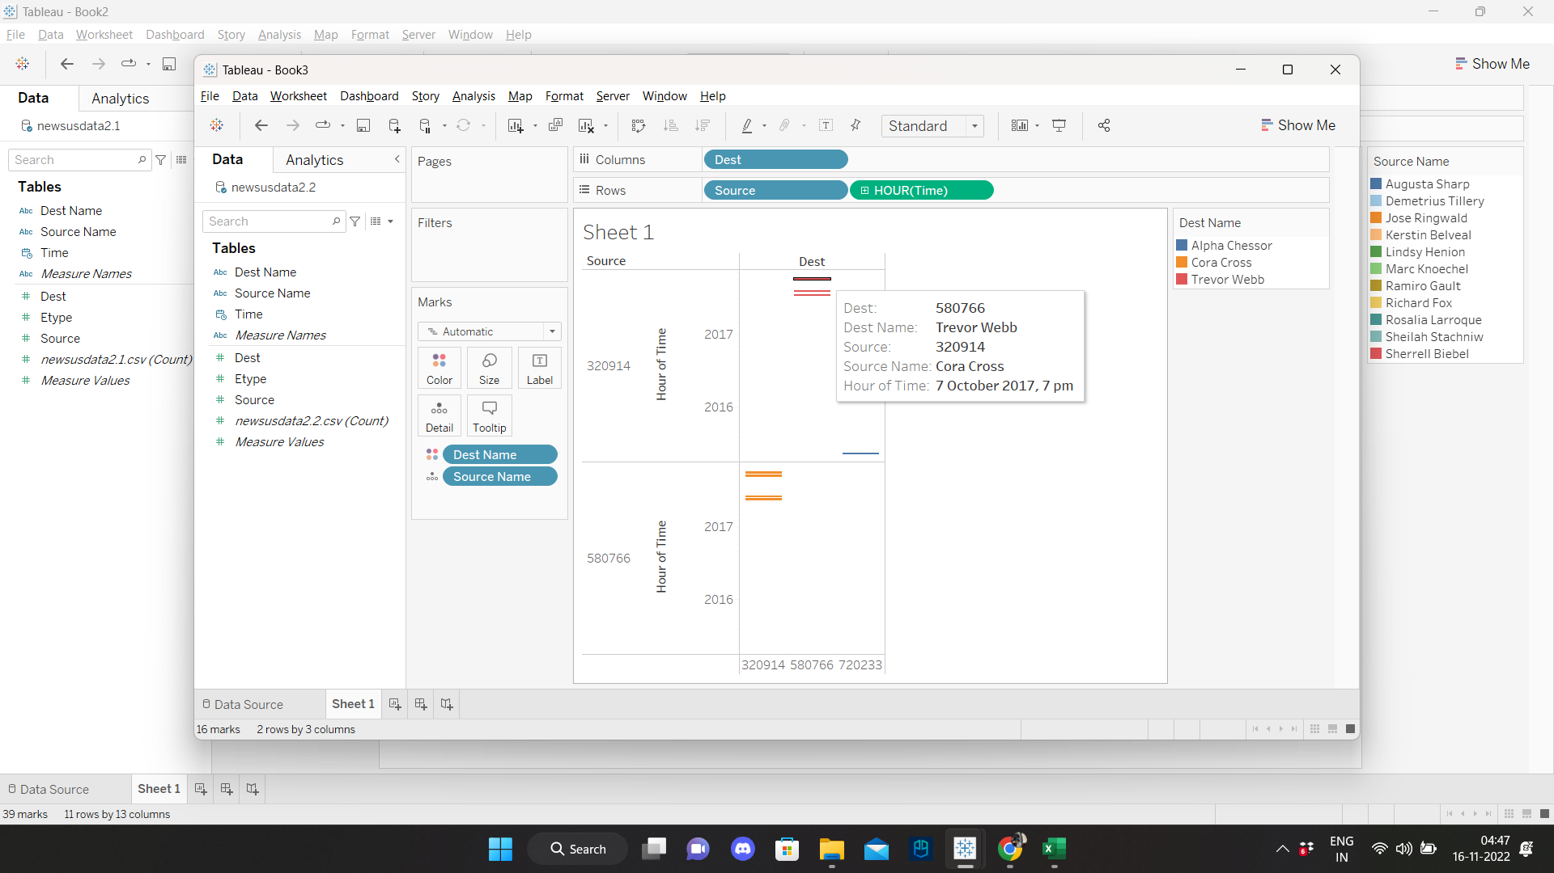
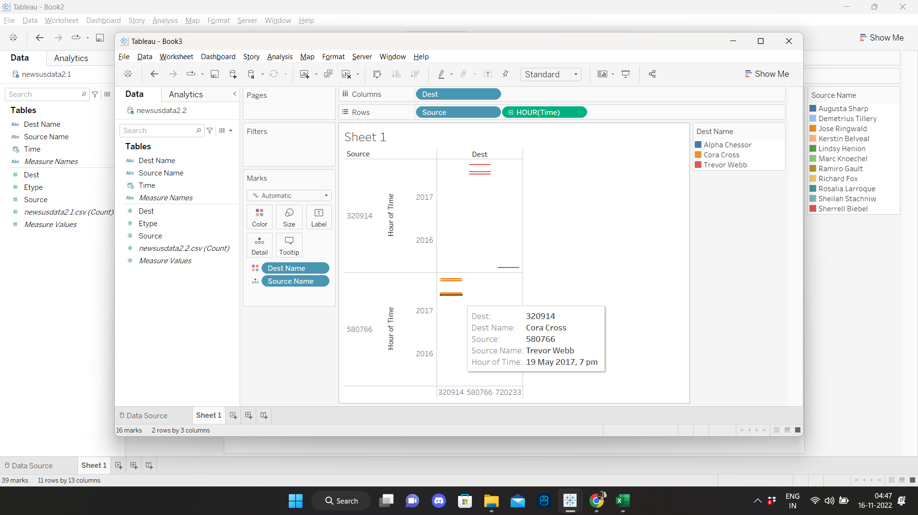

Analysing Cora Cross
Even though this person Cora Cross had so many conversations on different-different dates with the person between whom the purchase happened, yet after seeing her time stamp of conversation we can conclude that she must be legit to have meeting time scheduled at the same time, every time at 7pm before deals were closed. Hence, we opt her out of suspicion.

Slide 43
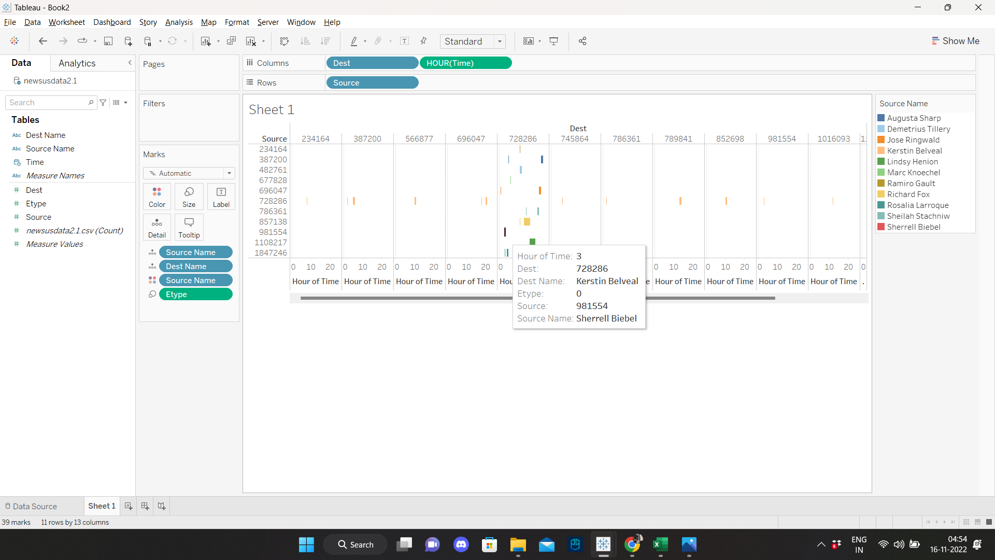

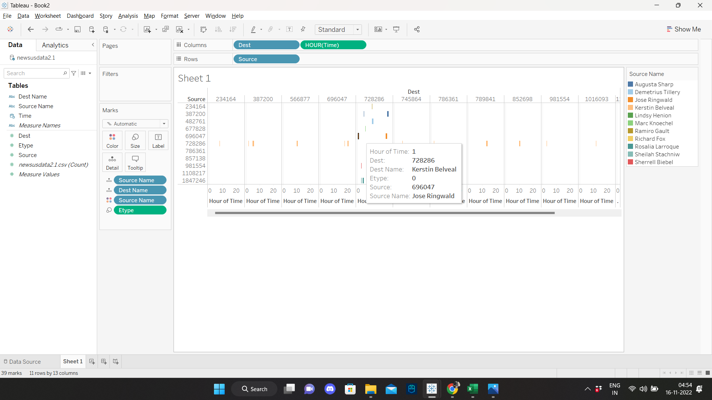
Analysing Kerstin Belveal
This person has so many calls done late night who are already in the list of suspicious purchases and not only that, he has repeated clients with whom the suspicious purchases were done. I find him and the group of people suspected of making some deal at nights.

Slide 44
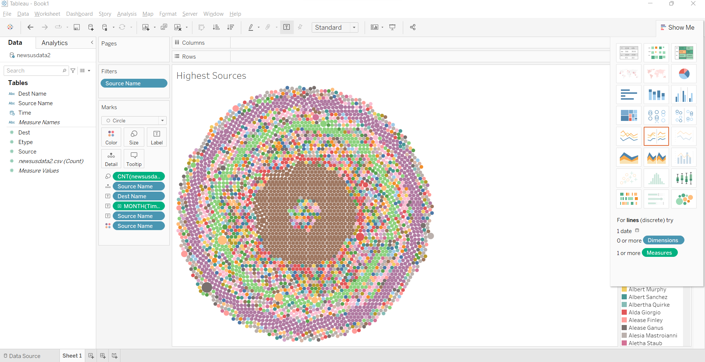
Highest Sources
The pattern of sources is depicted in the circle graph below, where different colors indicate various source sizes. The highest one is colored a greyish brown, while the smallest one is brown in color.

Slide 45
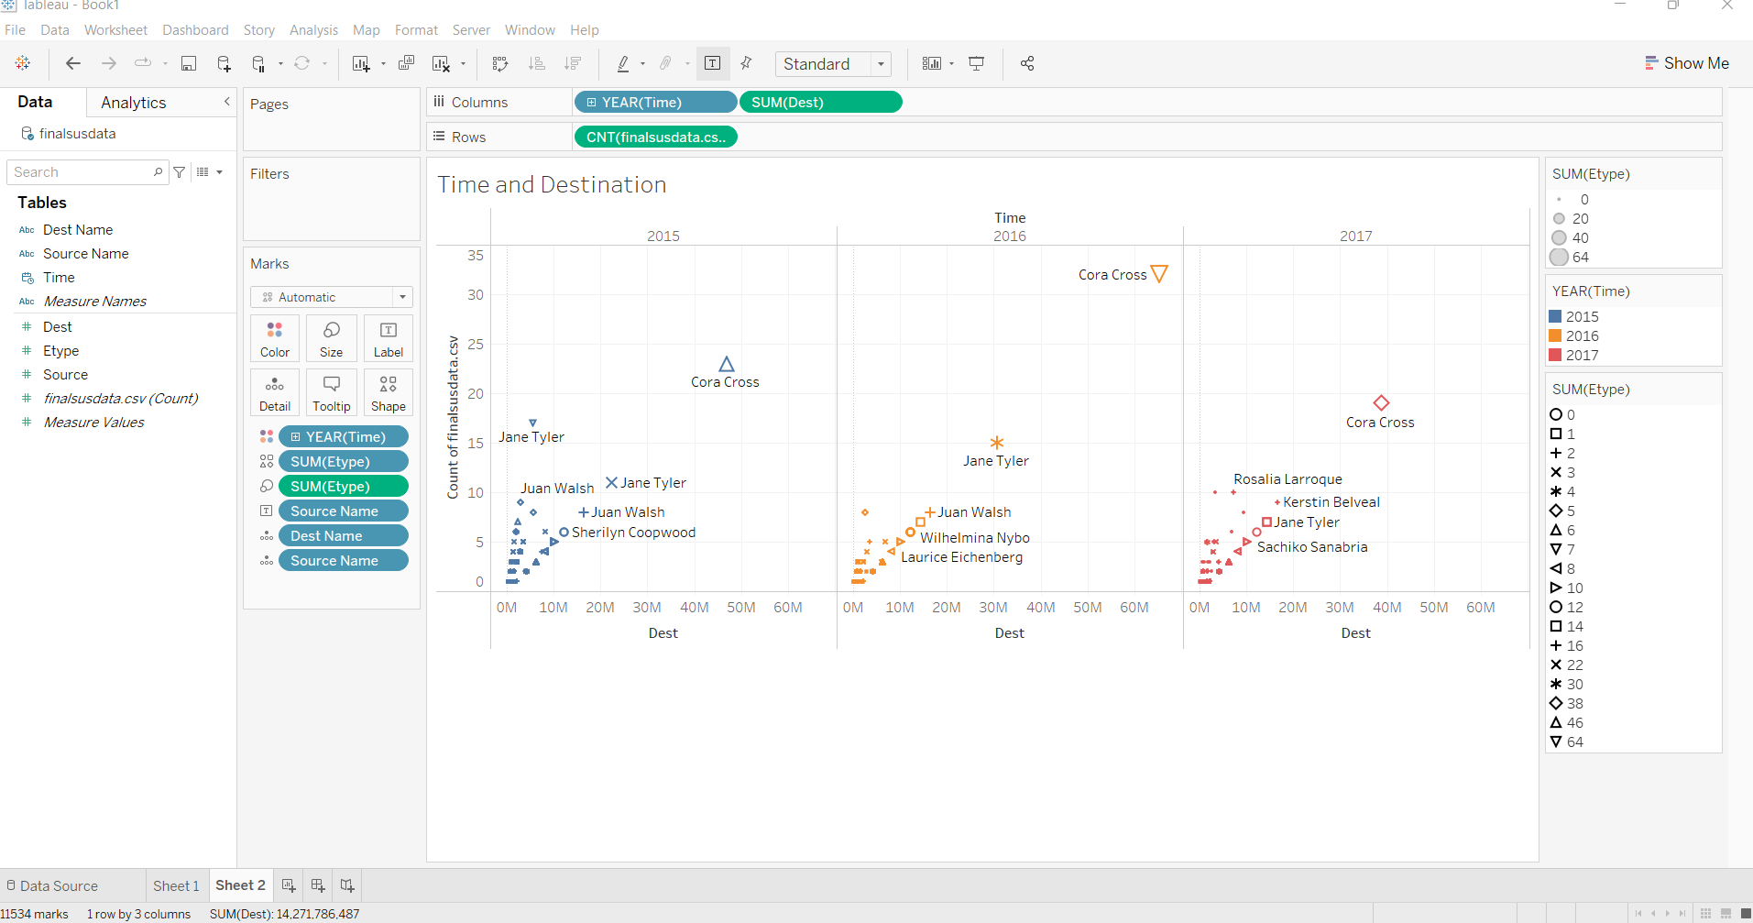
The comparison between the destination and the previous three years is shown in the following graphs, where suspicious people are defined by various shapes, colors and size.

Slide 46
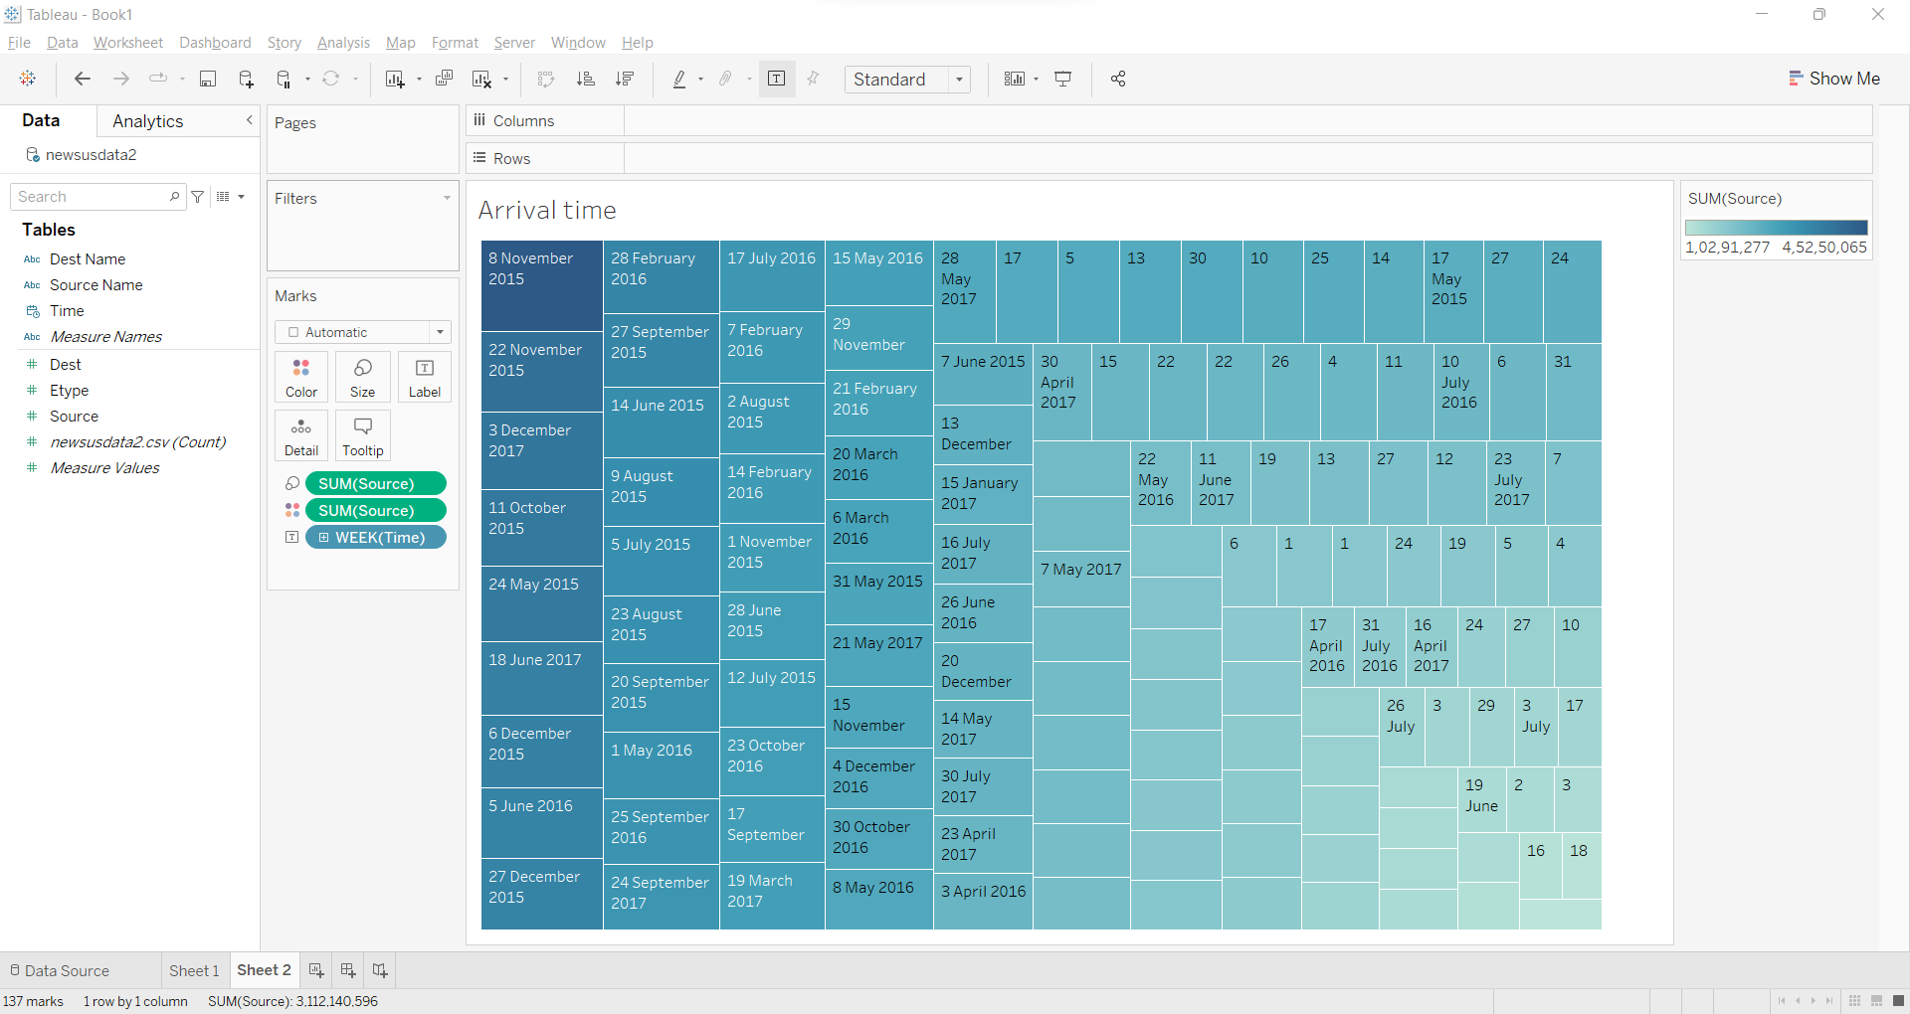
Arrival Time
The treemap displays the sources' travel times, with each color representing a different source's week and travel time . For more information labels are also added to it.

Slide 47
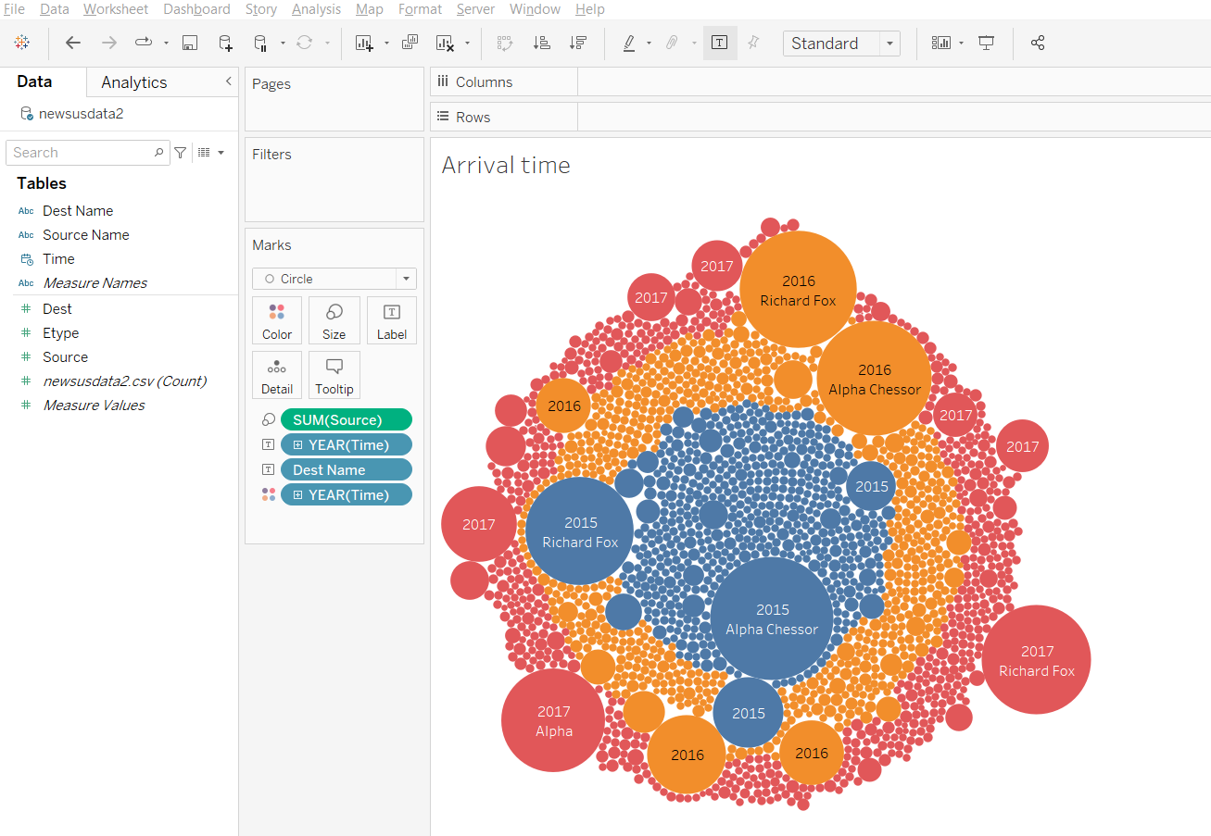
The following displays the sources' travel times, with each color representing a different source's year and travel time with labels added to it for more details.

Slide 48

The lines displays the sources' travel times, with each color representing a different source's month and travel time.

Slide 49

Rosalia Larroque have conversations with Kerstin Belveal before and after making a purchase on November 9th. Kerstin Belveal was on our list of suspicious people so it’s safe to assume they are suspicious.

Slide 50

Laure Pelkey is not suspicious because outside of the purchases she made, has no communication with the suspicious group.

Slide 51

Jenice Savario talked to Rosalia Larroque the day before making a purchase. They are suspicious.

Slide 52

Fairy Boratko has made 2 suspicious purchases and one is with Alpha Chassor so they are definitely suspicious.

Slide 53
New List of Suspicious People
Alpha,Chessor,720233
Rosalia,Larroque,1847246
Jenice,Savaria,2038003
Fairy,Boratko,2040339
Tyree,Barreneche,2038138
Trevor,Webb,580766
Beth,Wilensky,437025
Cora,Cross,320914

Slide 54

Using that list of new employees, I made a new data set using pandas only including data from this list.

Slide 55

Employees form of Communication and Times
This chart displays the times and form of communication that was used among employees.

Slide 56

Employees Cora Cross and Alpha Chessor communicated the most out of the other employees in the dataset.

Slide 57

Sketch Designs # 1

Slide 58

Sketch Design # 2

Slide 59

Final Sketch Design

